Slide 1
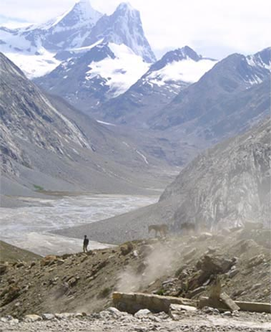
Fellowship of the Heart
Getting Started — the Four Connects, walked around the table on alternating evenings
Evening Series 2026–27 · at the Tittle home · v1.5E DRAFT
All Scripture: ESV · The Companion lesson plans carry the full scripts — these slides carry the room
1
Notes:
DECK TITLE · pre-session · DIVIDER
On screen as the room assembles on night one. All Scripture ESV; the plans carry the scripts; these slides carry the room — and these notes carry you.

Slide 2

SESSION 14
Second Running: Block A
The rotation’s evening — another willing teen takes a full leading rep with a practice the room already owns
Quarter 3: Mission & Rhythm
177
Notes:
S14 · pre-session · DIVIDER
On screen through dinner and as the circle forms. Greet at the door — the slide holds the room.

Slide 3

Session 14 — Tonight’s Road
1 Welcome and opening container
2 The mission round
3 Why tonight — the rotation’s charter
4 Closing container
5 Leader Feedback Round
6 Aaronic blessing and sending
178
Notes:
S14 · 7:00–7:08 · LEAD: CONTAINER HOLDER · TEEN-LED
BEATS: 1. Today a willing teen leads end to end; nothing new is taught — the every-teen rotation is the curriculum. 2. The middle runs ONE of two options, decided at the prep meeting with the leading teen — never improvised on the night: Option 1 = PROAPT in pairs on a fresh passage (chosen if the daily practice thinned); Option 2 = the full opening container from memory plus a Family Conversation Cards round (chosen if the room needs warmth). Confirm before the door opens which was called, and who today's catch adult is.
CUES: Adults sit outside the circle, eyes on the teen, faces warm and unhelpful; the catch sits where the teen can find their eyes.
GUARD: The teen leads practices only — anything heavy hands to the adult immediately, and the handoff is honored publicly as leadership, not failure.

Slide 4
Opening Container — the Eight Steps
1 Welcome — five minutes to open the container
2 Phones silenced and put away
3 Stand in a circle
4 One-word check-in — how you actually are, right now
5 Put out / bring in — set something down; bring a blessing in
6 Spoken commitment: “I am here. I am paying attention. I am willing to be moved.”
7 Opening prayer — “Holy Spirit, you are welcome here. Speak. We are listening.”
8 Sit. Begin.
179
Notes:
S14 · 7:00–7:08 · LEAD: CONTAINER HOLDER · TEEN-LED
BEATS: 1. The leading teen opens: phones away, blessing first. 2. Option 1: the short container restatement — Safe, Present, Clear, Intentional — then straight to the check-in word. Option 2: this IS half the rep — the full protocol from memory: standing circle, one-word check-in, put out / bring in, the spoken commitment, prayer naming the Holy Spirit. Measure completeness, not polish.
CUES: From the teen's first word, sit back outside the circle — the room learns who is leading from where the adults look. If the teen freezes: the catch counts silently to ten, steps in warm and seamless at the next one-liner, offers the lead back at the next step. No flag on the play.

Slide 5
The Mission Round
• The Mission night sent us home with one assignment — one small act, lined up with your downhill mission
• “One sentence each, whoever wants: what was your one act, or what got in the way?”
• “‘I didn’t get to it’ is an honest sentence.” A parent opens; pass anytime
• “The works were prepared beforehand; we keep walking into them. That assignment doesn’t expire.”
180
Notes:
S14 · 7:25–7:27 · LEAD: CONTENT PRESENTER · TEEN-LED
BEATS: 1. One round on Week 13's assignment: one small act aligned with your downhill mission. 2. One sentence each, entirely optional — 'I didn't get to it' is an honest sentence. 3. Receive them all the same way; the close: the works were prepared beforehand — the assignment doesn't expire.
CUES: The arranged parent opens (Run Card) — never a cold call on a teen; pass anytime.
GUARD: An acknowledgment, not a debrief — don't let it become a testimony hour or a guilt audit.

Slide 6
Why Tonight — the Rotation’s Charter
• Nothing new gets taught tonight — on purpose. Everything we do, this room has already done
• See one, do one, in front of each other — every one of us who is willing, not just the seniors headed for commissioning
• “My turn is tonight. Somebody else’s turn is coming.”
• This is not a competition — no ranking. The room’s job for every leader is the same: receive them
• “The team is here. But the practice is ours now.”
1 TIMOTHY 4:12
“Let no one despise you for your youth, but set the believers an example in speech, in conduct, in love, in faith, in purity.”
181
Notes:
S14 · 7:27–7:28 · LEAD: CONTENT PRESENTER · TEEN-LED
BEATS: 1. Say it plainly: nothing new today, on purpose — everything we do, this room has already done; one more of us leads it. 2. 1 Timothy 4:12 is the charter: let no one despise your youth; set the believers an example. 3. Name the score-keeping out loud: not a competition, no ranking — the room's job for every leader is the same: receive them.
GUARD: Today is not filler between the Mission week and the Rhythm week — it is the mechanism. Say so.

Slide 7
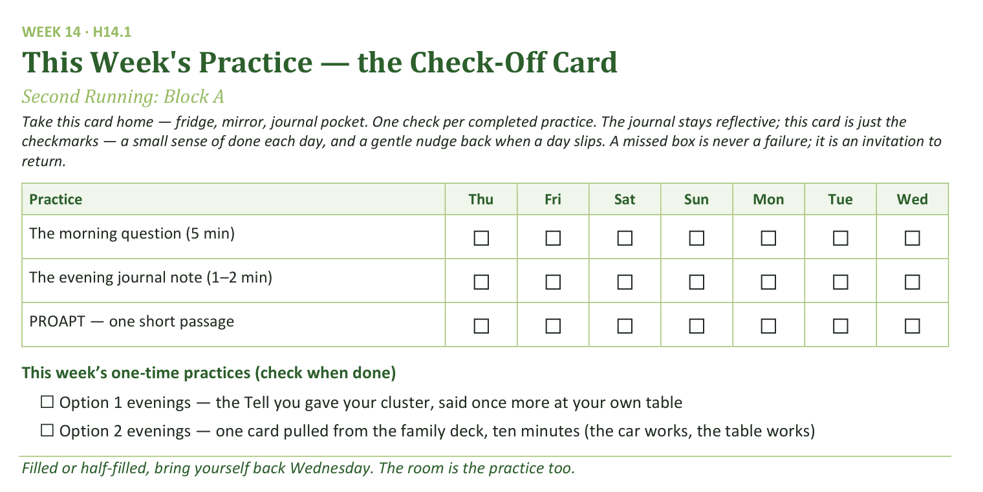
Your Take-Home Card — This Session’s Practice
Handed out now — fridge, mirror, journal pocket.
182
Notes:
W14 · ~5:12–5:19 · TEEN-LED (the merge block)
BEATS: 1. The daily rhythm continues: the morning question, the session note, PROAPT one short passage. 2. Option 1 nights: the Tell you gave your pair, said once more at your own table this week. Option 2 nights: the family deck comes off the shelf once — one card, ten minutes; the car works, the table works. 3. A missed box is never failure — an invitation to return.
CUES: This lands in the teen's merge block (5:16 in Option 1, 5:12 in Option 2) — the teen says it, not you.

Slide 8
Closing the Container + Aaronic Blessing
• We close the way we opened — the container, six steps:
1 Stand again — same circle, same posture as the open
2 One-word landing — compare it to your opening word
3 The one thing you are taking from tonight
4 The one practice — committed aloud, or modified to one you will actually keep
5 Blessings — specific, witnessed, short
6 Closing prayer — and the Aaronic blessing, spoken over each other, face to face
THE AARONIC BLESSING — NUMBERS 6:24–26
“The Lord bless you and keep you;
the Lord make his face to shine upon you, and be gracious to you;
the Lord lift up his countenance upon you, and give you peace.”
183
Notes:
W14 · 5:19–5:23, blessing 5:27–5:30 · TEEN-LED
BEATS: 1. The teen runs the closing protocol: standing circle, one-word landing, the one thing, the one practice spoken aloud. 2. After the feedback round the teen returns for the send: when we gather is the Rhythm night — today was a rep of exactly that, the practice working without the team at the front. 3. Aaronic blessing, hands up; sent.
CUES: In Option 2, closing from memory completes the container half of the rep — let the teen carry all of it.

Slide 9
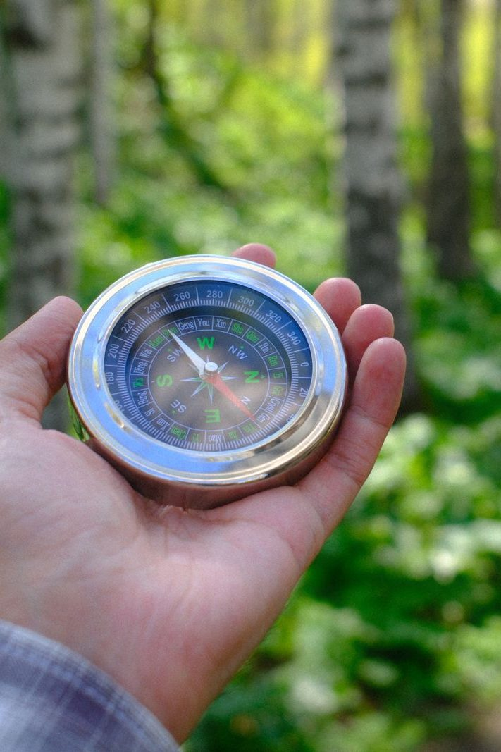
The Leader Feedback Round
• Two rounds, same as every session — the container holder first, then the content presenter: three things each
– “What I think went well tonight: ______”
– “What I’d do differently next time: ______”
– “If I were to teach tonight’s process to someone, I would tell them: ______”
• Then the room — the same two questions about tonight
• The leaders receive without defending — “thank you” is the whole response
184
Notes:
S14 · 8:24–8:28 · LEAD: BOTH LEADERS (Lead Companion runs)
BEATS: 1. The leading teen answers first: went well / do differently / what I'd tell someone teaching this. 2. The adult answers the two questions second, adds ONE specific affirmation of the lead and at most one growth item. 3. The room only by the teen's consent — ask aloud; popcorn, 'for you' language; two or three voices each. 4. Receive without defending — 'thank you' is the whole response.
GUARD: If the catch stepped in today, name what the teen did well FIRST; the stepping-in was the team working, not the teen failing. If the teen declines the room's round, it ends after the adult — no pressure, no exposure.

